Slide 1
+
Institute of Software Technology
Predicting and Learning the Performance of Configurable Systems
Seminar Advanced Software Engineering

Slide 2
Motivation and Problem

Slide 3
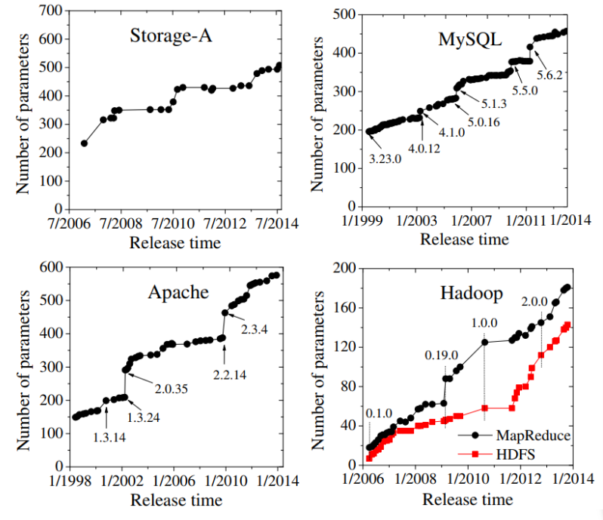

Motivation: More Configurations appear
Programs are getting more and more configuration options.
Notes:
Todays programs are getting more configurable
Good for stakeholders and customers
Enables tailoring for specific requierments

Slide 4
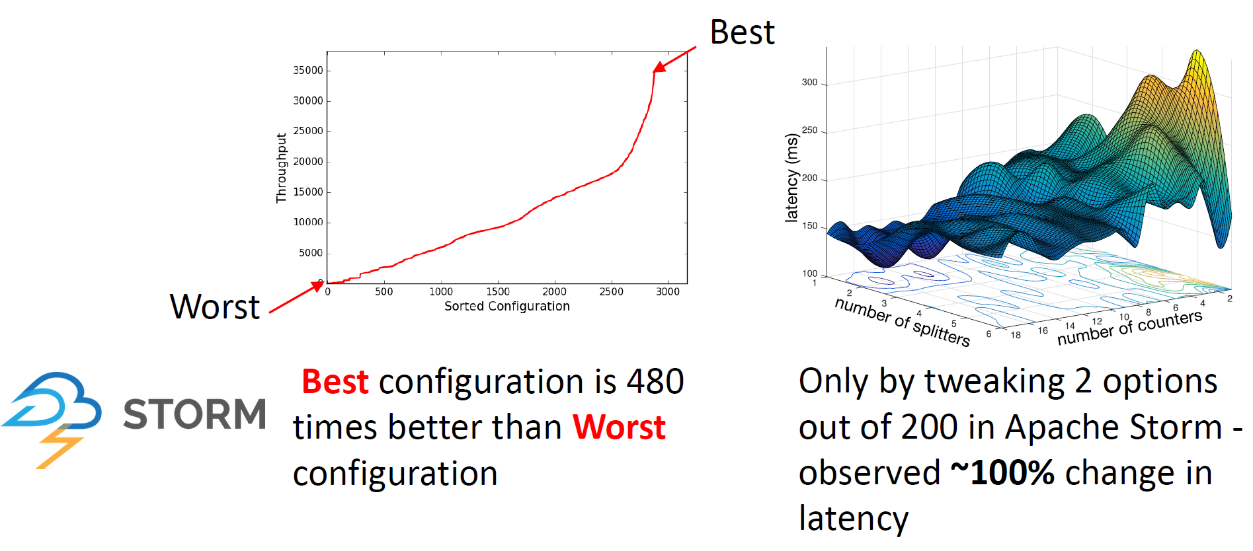
Motivation: Configurations matter!
But: Bad configurations can have a big impact on performance:
More Configurations
More Possibilities of Performance Influences
Performance prediction is hard.
Notes:
Greate performance diffrences between configurations of the same system.
Change of 1 option can make a huge difference
-> hard to predict

Slide 5

Motivation: Configurations matter!
Reason for performance prediction:
Finding optimized configurations
Finding good default configurations
Find problems in the implementation
Proof a good average performance
Can’t we just measure every configuration?

Slide 6

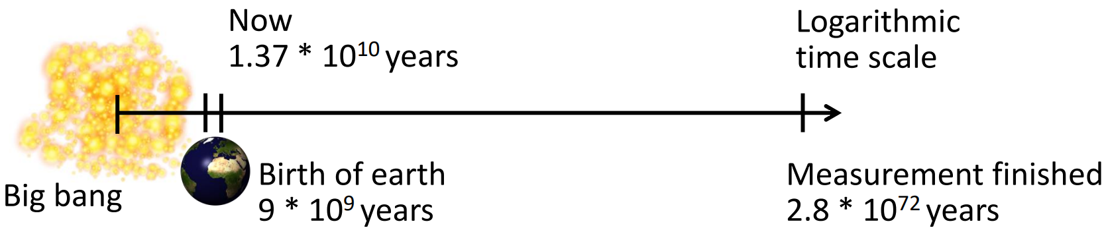
The Problem: Examples
Have a look at Berkley DB (C):
19 features
2560 configurations
426h (~18d) for brute force testing
Let’s go larger!
with SQLite!
77 features
3∙10⁷⁷ configurations
Assumption: 1 measurement = 5min (compilation + benchmark)
Notes:
Berkley DB ~ 10min per config.
Literally not doable for sqlite
Actual problem appears on this slide

Slide 7
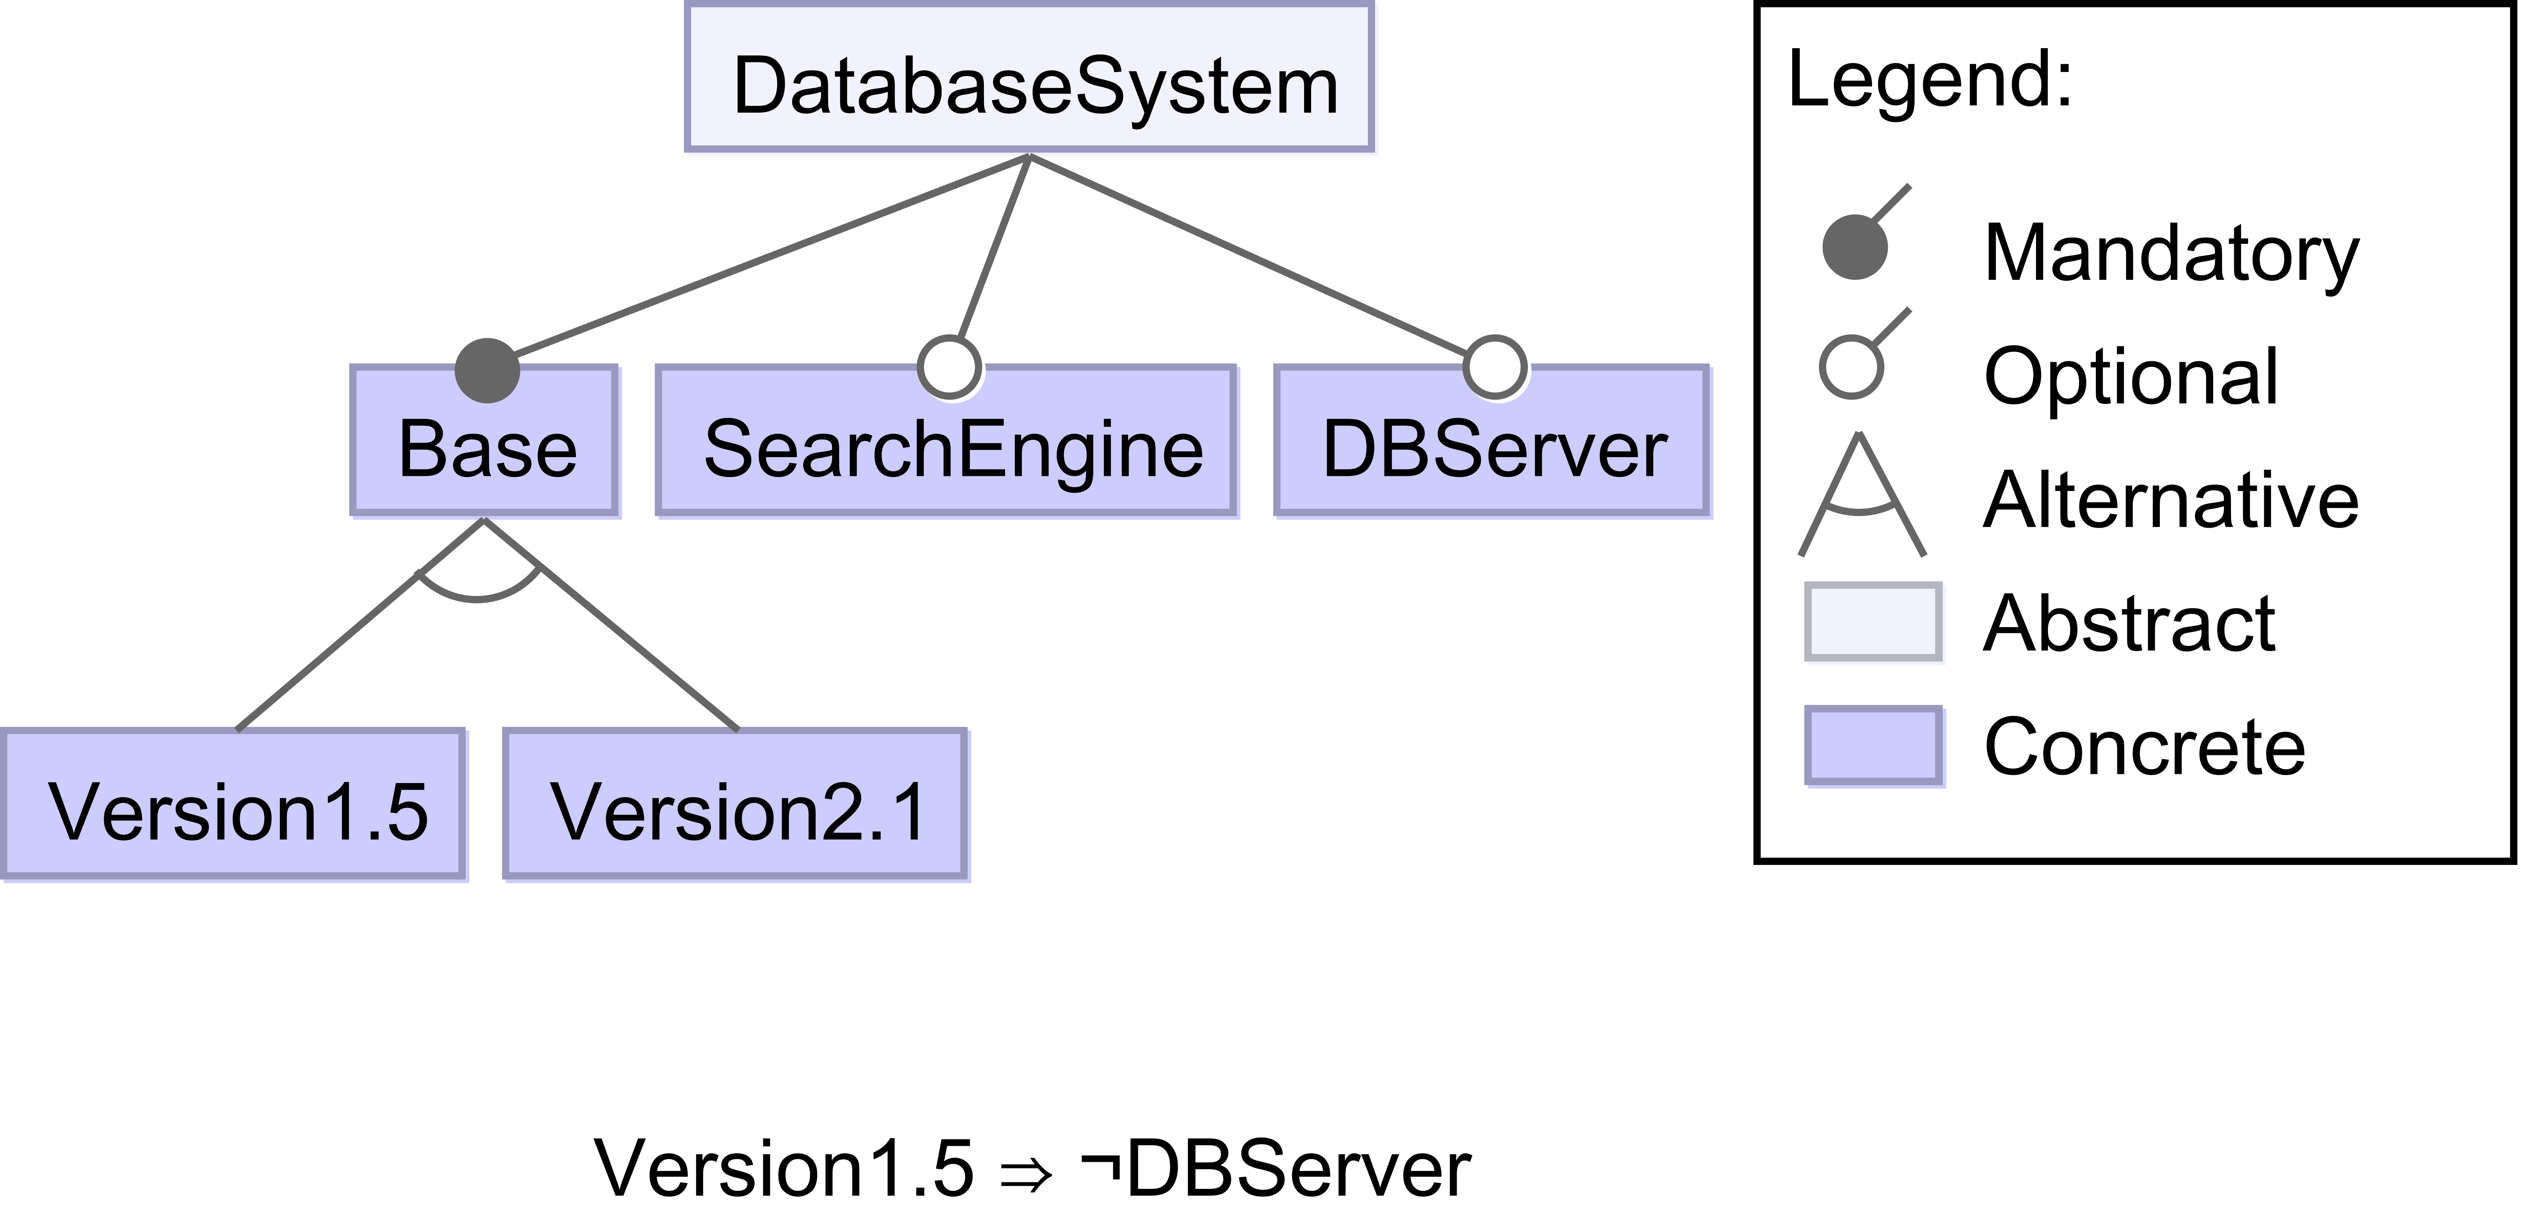
The Problem: Exponential Configuration Space
Presentation of valid configurations as Feature Model
⇔
Valid = Base ∧ (Version1.5 ⊕ Version2.1) ∧ (Version1.5 ⇒ ¬DBServer)
Example: Default = {Base = 1, Version2.1 = 1, SearchEngine = 0, DBServer = 0}
⇒ all valid configurations (Configuration Space) ∈ O(2^{#options})
Notes:
self explainatory feature model
Equivalent to a logical expression (with help of annotations)
How many valid assignments? => O(n^2)

Slide 8
Performance Learning and Prediction

Slide 9
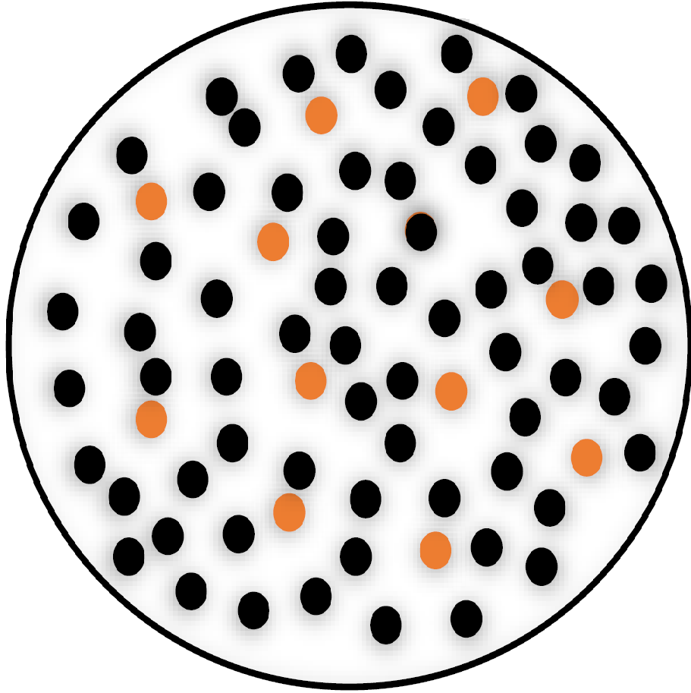
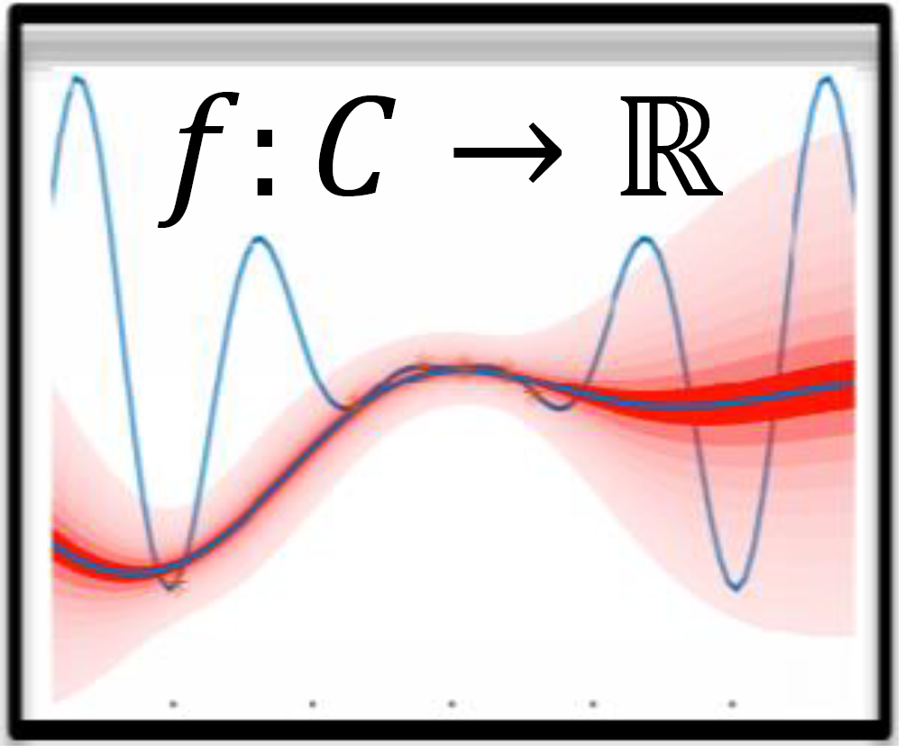
The General Approach
Sampling
Learning
Prediction
Optimization
Analysis
Presented Techniques:
Brute Force
Automated Features Interaction Detection
3 different sampling strategies
Notes:
General approach
Sampling -> reducing/filtering of the exponential configuration space (main problem)
Learning -> application of machine learning techniques
Brute force not feasible
AFID a non machine learning approach
Different sampling strategies

Slide 10
Automated Feature Interaction Detection
Goal: Assign a performance influence value ∏ to each feature (interaction).
A simplified example:
System S w/o features
∏(S) = 100
System S with a
∏(Sxa) = 110
System S with b
∏(Sxb) = 95
System S with a and b
∏(Sxaxb) = 103
∏(Sxa) = ∏(S) + ∏(a)
⇒ ∏(a) = 10
∏(b) = -5
∏(Sxaxb) = ∏(S) + ∏(a) + ∏(b) + ∏(a#b)
⇒ ∏(a#b) = -2
Notes:
b speeds up a aswell -> Sxaxb = 103 \= 105

Slide 11
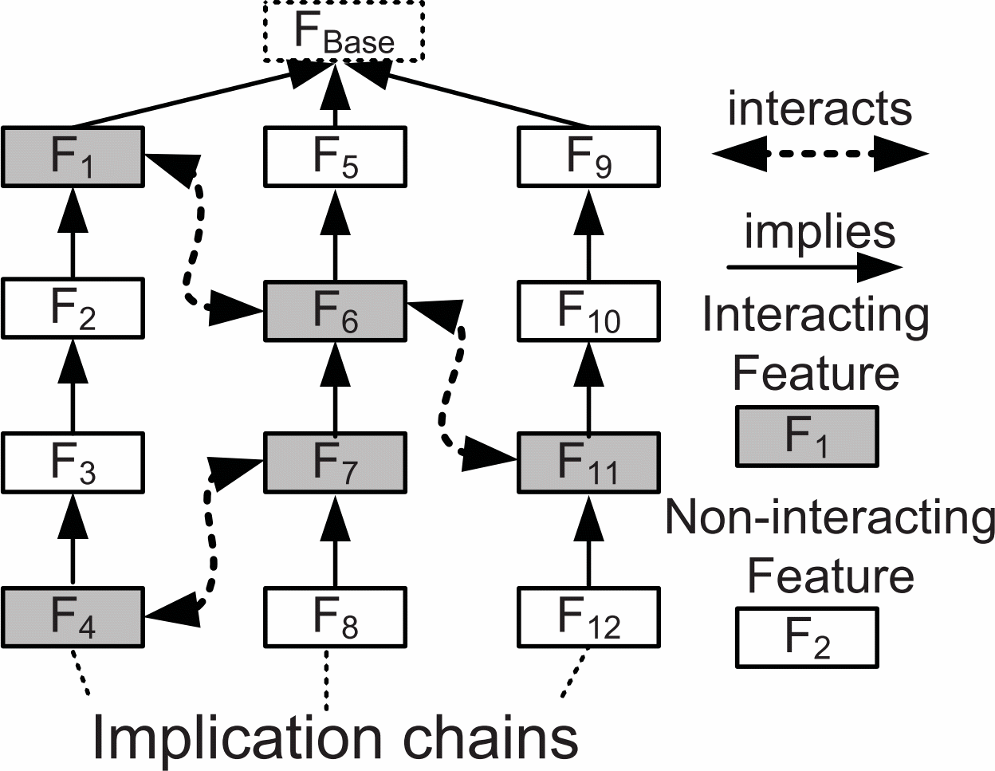
Automated Feature Interaction Detection
Step 1: Find interacting features
for each feature f do…
∏(f)=∏(min(f)×f)-∏(min(f))
Measure and compute
∏(min(f)×f)
∏(max(f)×f)
yes
equal?
no
Mark f as interactive
Step 2: Measure feature interaction impact
Pair-Wise Heuristic
Measure Performance Impact
Higher-Order Heuristic
Isn’t this still factorial?
Hot-Spot Heuristic
O(n²) Pairs
Yes!
Notes:
Assign a performance influence value
2 steps:
Find interacting features
Measure interactions based on heuristics and implications chains

Slide 12


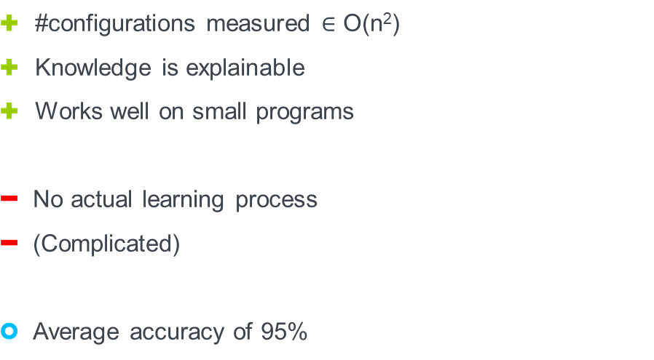

Automated Feature Interaction Detection
Advantages/Disadvantages
#configurations measured $∈$ O(n²)
Knowledge is explainable
Works well on small programs
No actual learning process
(Complicated)
Average accuracy of 95%

Slide 13
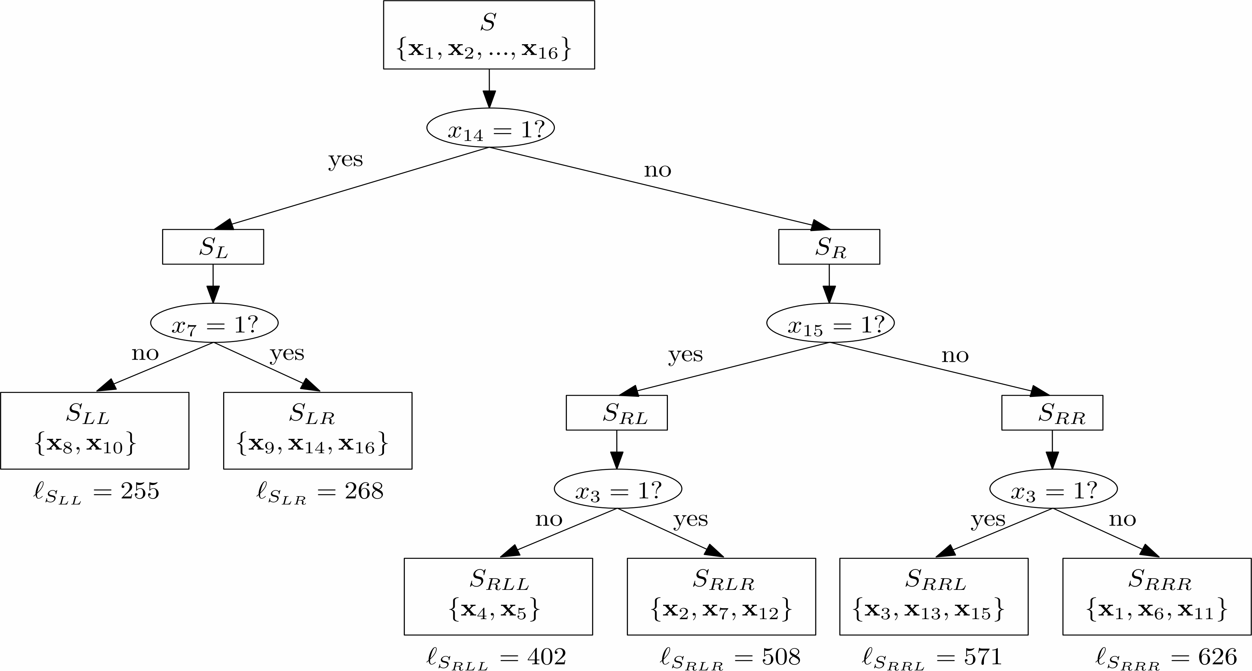

Classification and Regression Trees (CART)
Set of data points D + Evaluation Function + balancing Heuristic
Configurations are classified by thier performance values

Slide 14

Random Sampling
chose a random sample set
measure all chosen configurations
build a CART
random
all
simple to implement
randomized sample picking can be non-efficient
not accurate for small sample sizes
sample size is freely selectable

Slide 15
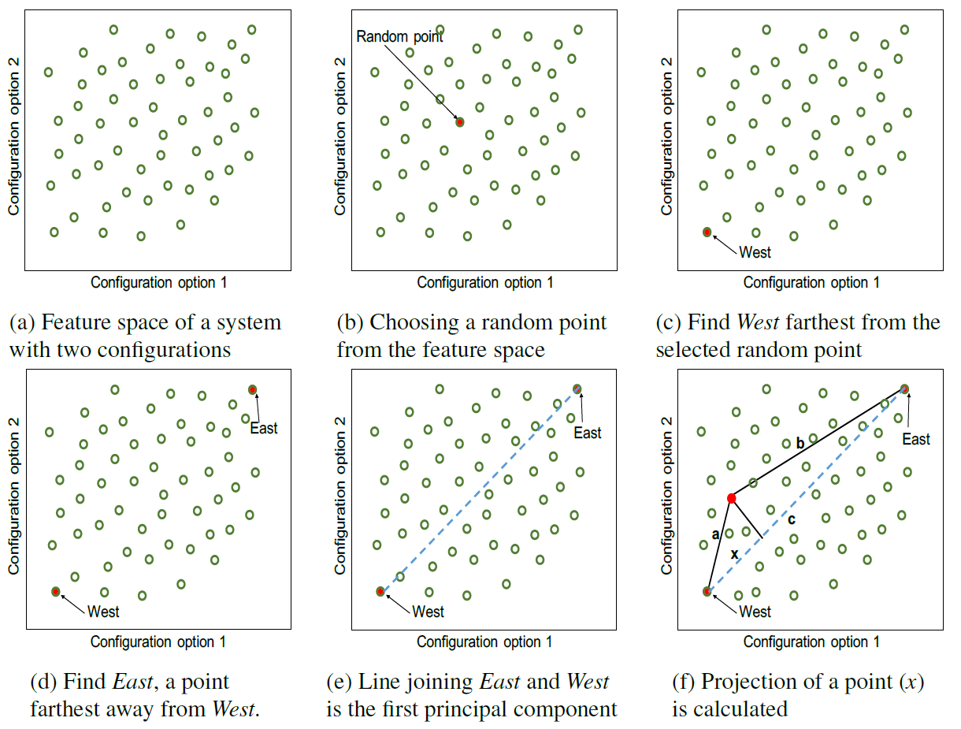
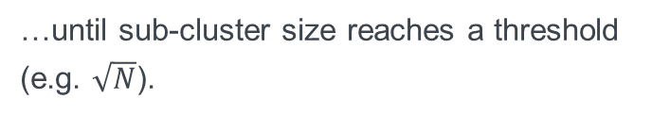
WHAT – Distance based Sampling
Uses a Spectral Learning like clustering method…
Clustering by distance vector between configurations.
Chose a random configuration from each leaf cluster and measure it.
Build a CART
…until sub-cluster size reaches a threshold (e.g. $\sqrt{N}$).
O(2n) comparisons
Other cluster algorithms are possible
Notes:
Arithmetic or geometrical distance of configurations leads to clusters that contain similar configruations
-> only 1 configuration measured for each leaf cluster
Other clustering algorithms are possible

Slide 16
WHAT – Distance based Sampling
Advantages/Disadvantages
O(2n) comparisons and #sub-clusters configurations measured
Can be used for numeric and boolean options
run time and accuracy are strongly depended on termination criteria
not useable for non-numeric options
Up to 97% accuracy

Slide 17
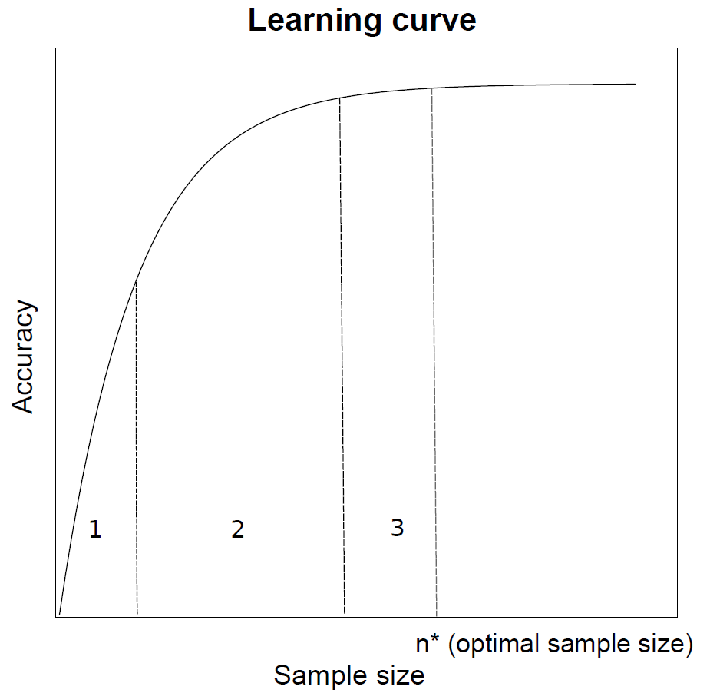
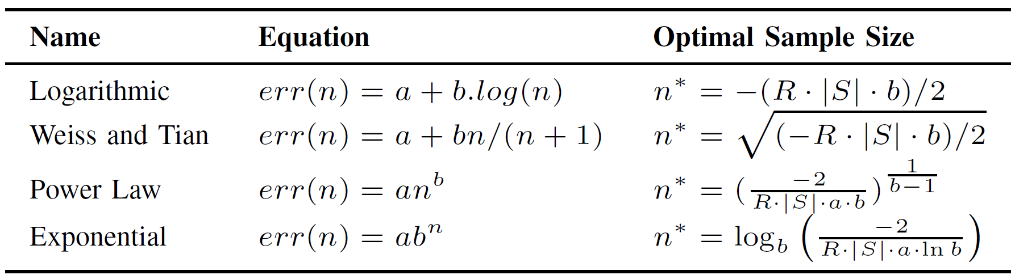


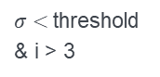
Projective Sampling
Tires to find an optimal sample size with curve fitting
iterative/randomized process
Function fitting
Substitute $err(n)$ with function and find minimum $=n^{∗}$
$σ<$threshold & i > 3
Start
i =1
Measure another random configurations
Insert into the CART
Evaluate mean error $σ$ of the CART
Evaluate mean error 𝜎 of the CART
Add point (i,1-$σ$) to learning curve
Add point (i,1-𝜎) to learning curve
i +=1
$$TotalCost\left(n\right)=2n+err(n)∙\left|S\right|∙R$$
Build CART
with an optimal
sized sample
Notes:
Takes advantage of knowledge on learning curves
Initial sample set is generated -> generates first part of learning curve
Curve fitting
Substitution and calculation of the optimal sample size

Slide 18
Progressive Sampling
Advantages/Disadvantages
also considers sampling cost
up to 99% accuracy
can use a significantly larger sample then other approaches
initial sample generation has high influence on accuracy

Slide 19
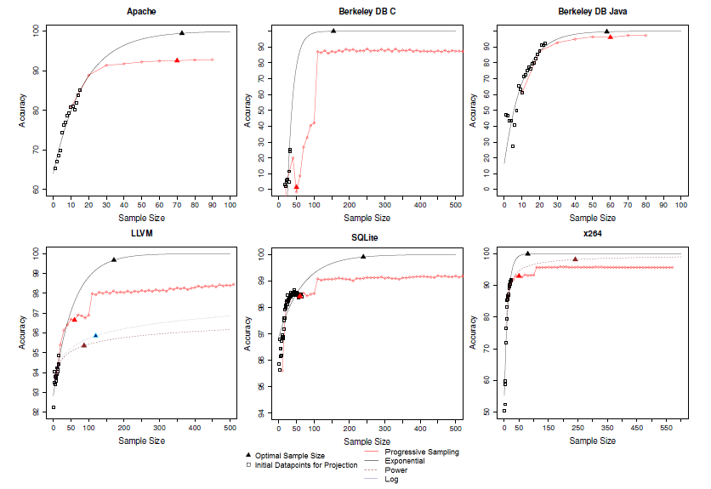
Example Learning Curves

Slide 20
Conclusion
Main Problem: Reduction/Filtering of an exponential Configuration Space
Solved by using good sampling techniques
Learning with typical machine learning strategies
Sampling
Random
Projective
Learning
CART
Neural Network
Distance Based
…
Transfer Learning
…
Prediction
Optimization
Analysis
a good balance between the sample size and accuracy is key
no perfect solution

Slide 21
Institute of Software Technology
Lion Wagner
st148345@stud.uni-stuttgart.de
Institute of Software Technology

